Slide 1

PROJECT RESULT

Slide 2
Agenda
Project objective
Data source
Dataset description
Methodology
Evaluation Results
Findings and Recommendations
Notes:
The presentation is divided into 6 parts. I will go through them one by one.

Slide 3
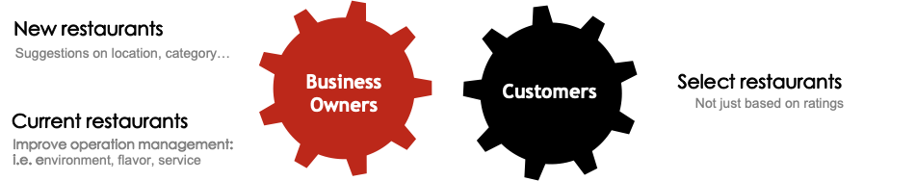

Project Objective
Leverage the findings of the Text Analytics to help
Notes:
The objective of this project is to inform business owners of actionable insights from customer reviews. Also, I give each review multi labels so that Yelp users could easily query those reviews by topics they are interested in.

Slide 4

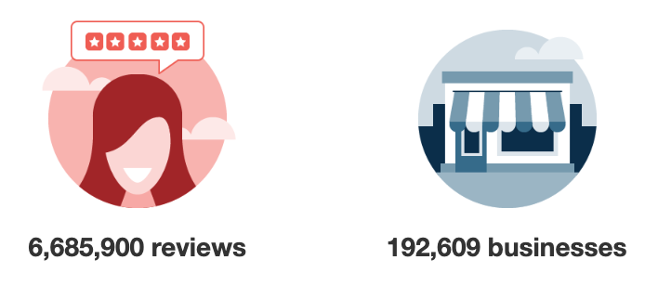
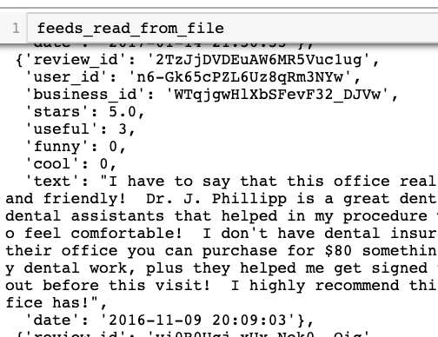
Data Source
71,126 Reviews
from 3999 restaurants
in JSON format
Filtering Condition:
Target city - Phoenix
Time span – 2018-2019
Business type - Restaurant
Notes:
The dataset was originated from the online Yelp Dataset. I wanna focus on all reviews for restaurant in Phoenix. Therefore, I got 70,000 reviews text from around 4000 restaurants in JSON format.

Slide 5
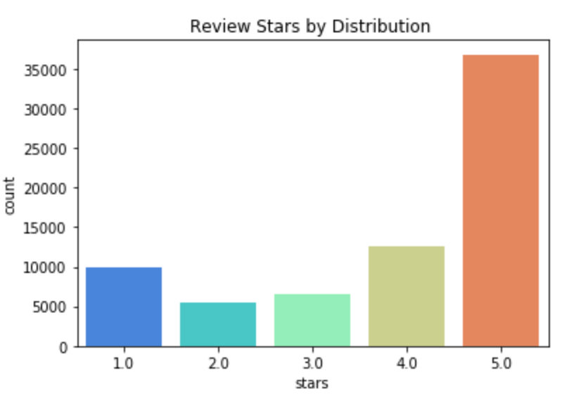
Dataset Description
Over 1/2 of reviews give 5 stars rating
Notes:
Let’s have quick overview of our dataset. I count the number of reviews by star and found over half of reviews give 5 stars rating. Looks like people are pretty satisfied with their restaurant experience.

Slide 6
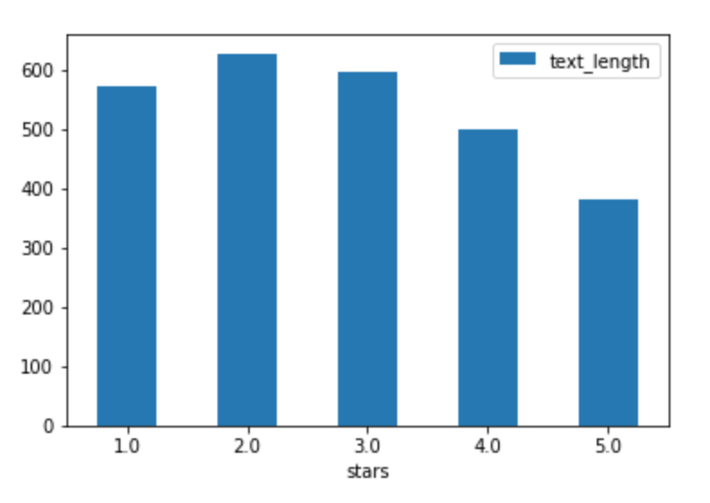
Dataset Description
Average Text Length by Stars
Those reviews with low ratings tend to be longer.
Notes:
Next, I calculated the average text length by stars. I found those reviews with low rating tend to be longer. It make sense that angry customers have more to complain.

Slide 7
INSIGHTS
PREDICTIVE ANALYSIS
Methodology
70,000+ Reviews from Yelp
REGRESSION MODELS
Categorized Dataset
Sentiment Score
Subjectivity
TOPIC CLUSTERS
TOPIC CLASSIFICATION
DEDUPLICATION
SENTIMENT ANALYSIS
SimHash +
Word2Vec
TOPIC MODELING
TOPIC MODELING
COUNT VECTORIZER
LDA
WORD2VEC
NAÏVE BAYES
CLASSIFIER
Clean Deduplicated
Dataset
Review Text

Slide 8


Methodology (cont.)
SUGGESTIONS ON
KEY PHRASE EXTRACTION
Service
Flavor
Insights
Environment
Customer
Insights
SENTIMENT ANALYSIS
PREDICT
PREDICTIVE ANALYSIS
Stars
Insights
Business Owner
+
Location

Slide 9
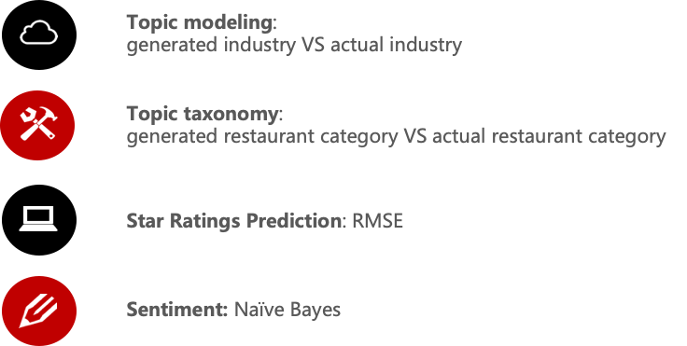
Evaluation Metrics

Slide 10

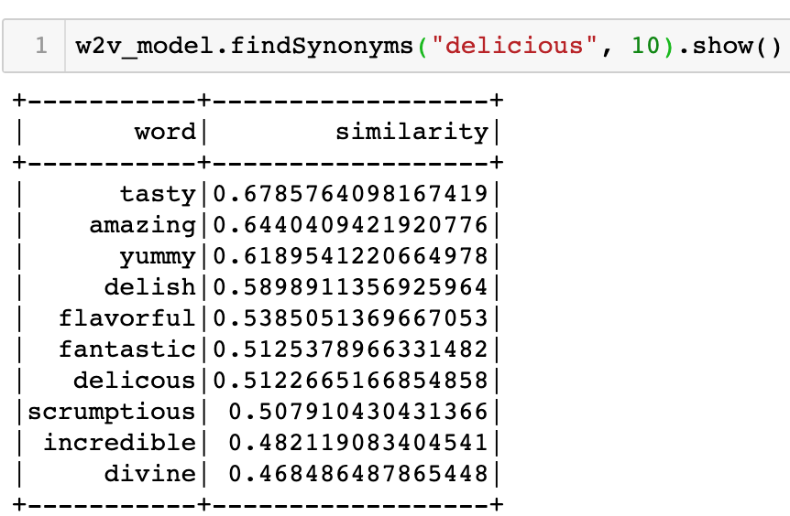
Evaluation Results - Deduplication
Deliverable: Trained Word2Vec Model
DEDUPLICATION
SimHash + Word2Vec

Slide 11
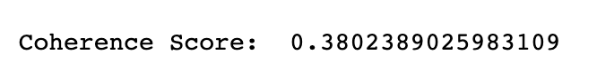


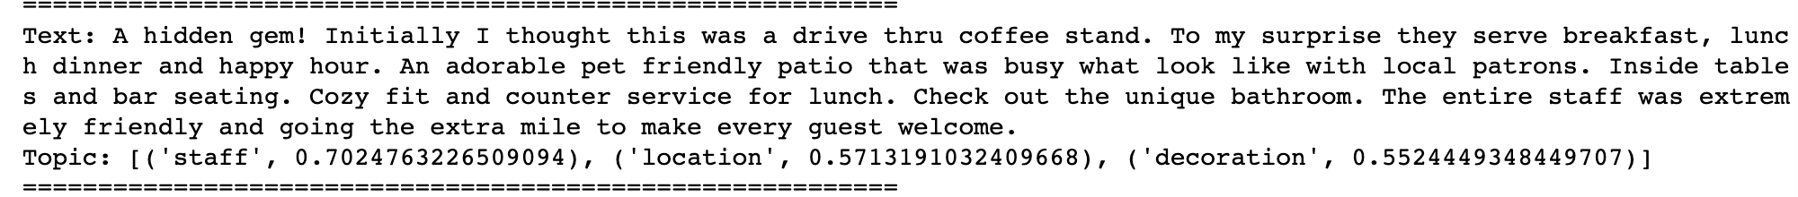
Evaluation Results – Topic Classification
TOPIC DISTRIBUTION
20 Topics
LDA
8 Topics
Google pre-trained model: Atmosphere, Staff, Location
TOPIC CLASSIFICATION
Word2Vec
Self-trained model: Staff, Location, Decoration

Slide 12
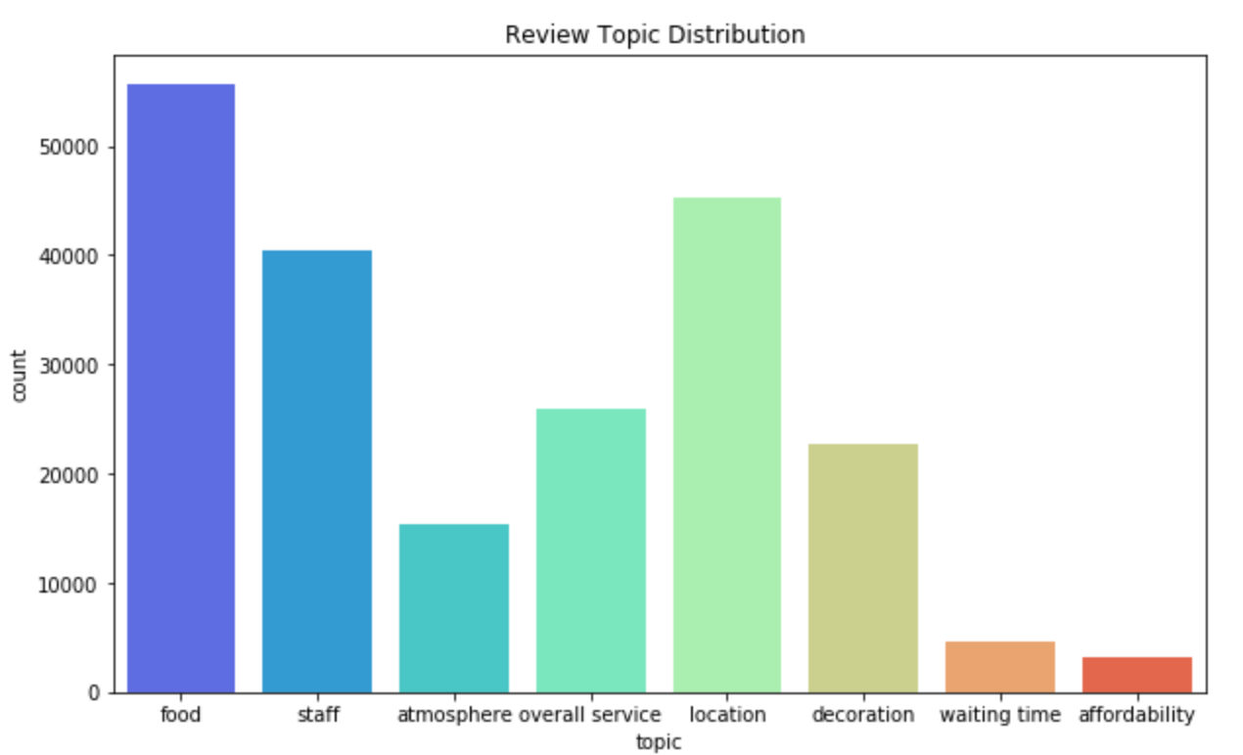
Finding - Topic Distribution
Top 3 topics are food, location and staff.
Notes:
Top 3 topics among reviews are food, location and staff

Slide 13
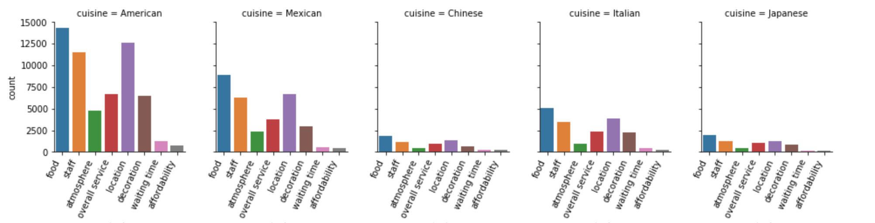
Finding - Topic Distribution by Cuisine
Notes:
Different type of restaurants share the same trends. People talks more about food, location and staff of this restaurant rather than their atmosphere or affordability. In addition, we can see American style restaurants are the most popular one, with the most discussion and number as well.

Slide 14
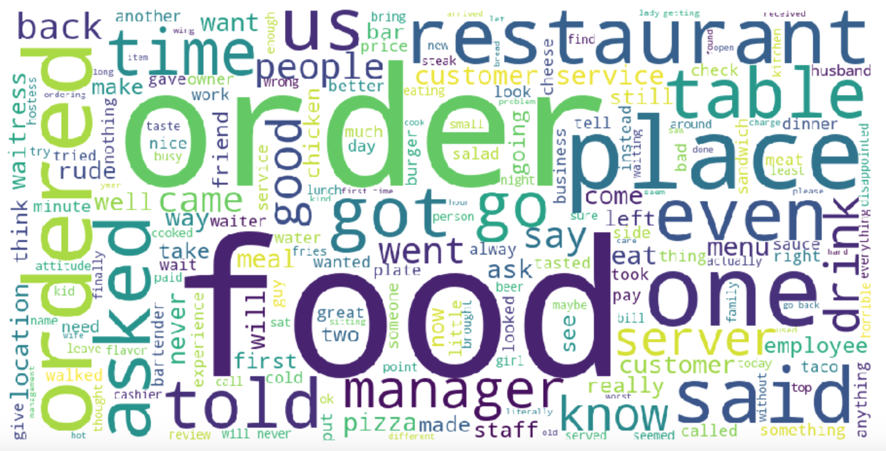
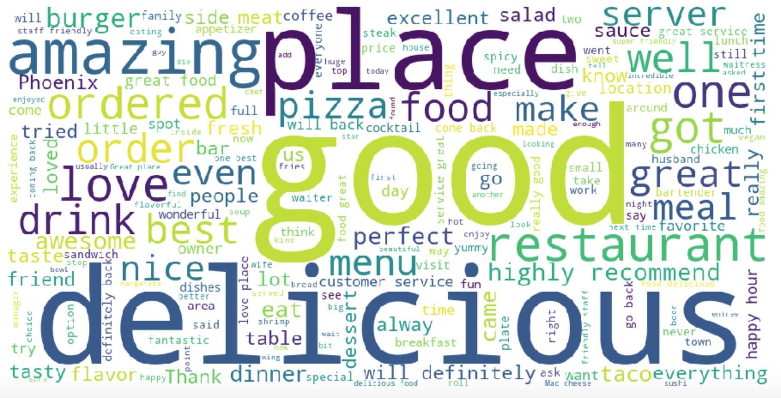
Finding – Word Cloud
1-star reviews in STAFF topic
5-star reviews in STAFF topic

Slide 15
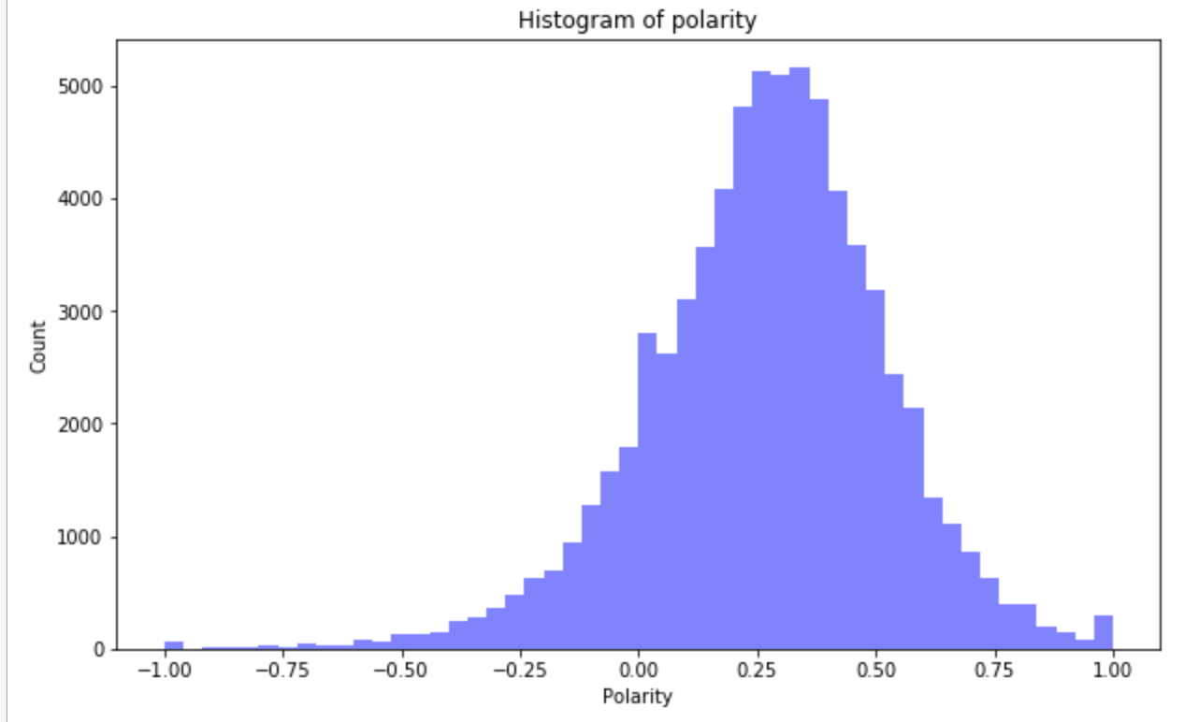
Finding - Polarity

Slide 16
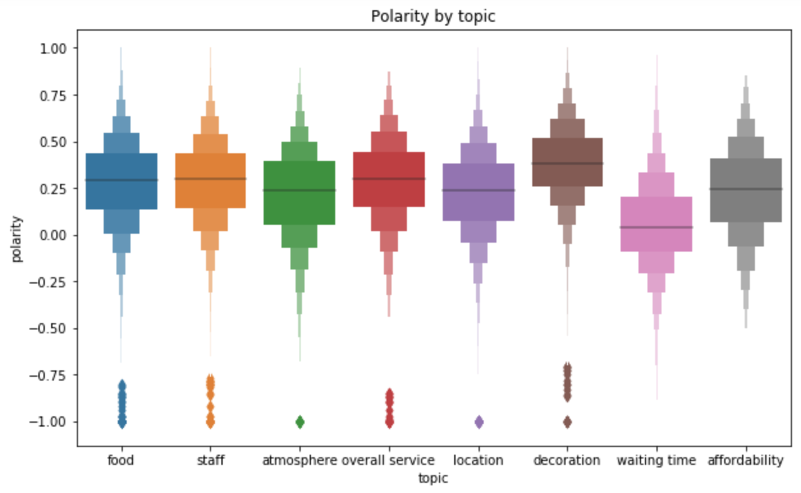
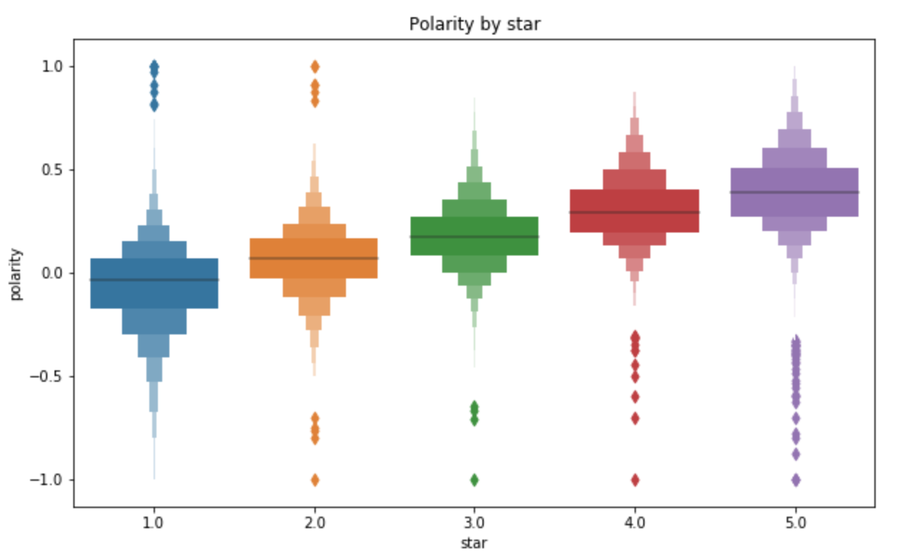
Finding - Polarity

Slide 17
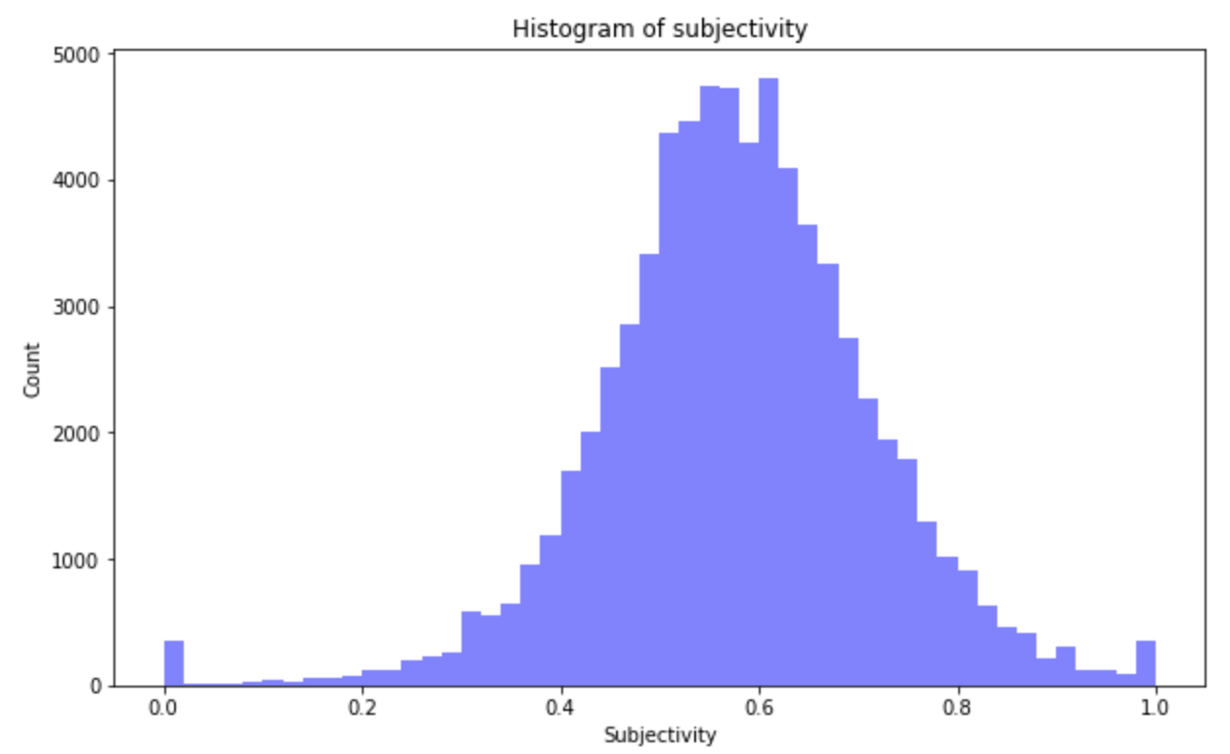
Finding - Subjectivity

Slide 18
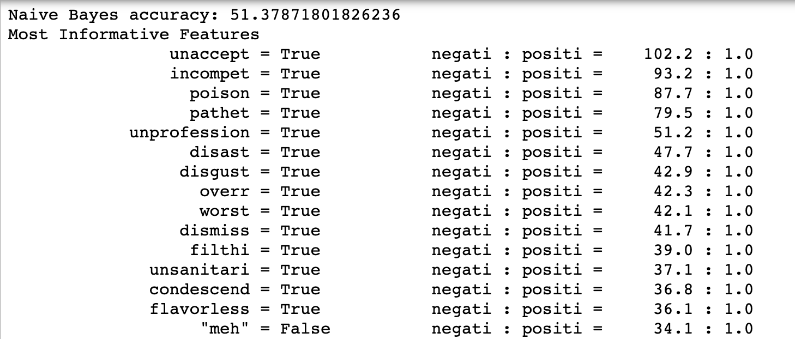
Sentiment Analysis – Nltk.Naïve Bayes classifier
Get stem words, label >=4 as ‘positi’, other as ‘negati’
Train / Test size: 49000/22122

Slide 19
Finding - Other Classifiers Sklearn
 | Logistic Regression | Linear SVC
Accuracy | 91.56 | 90.29

Slide 20
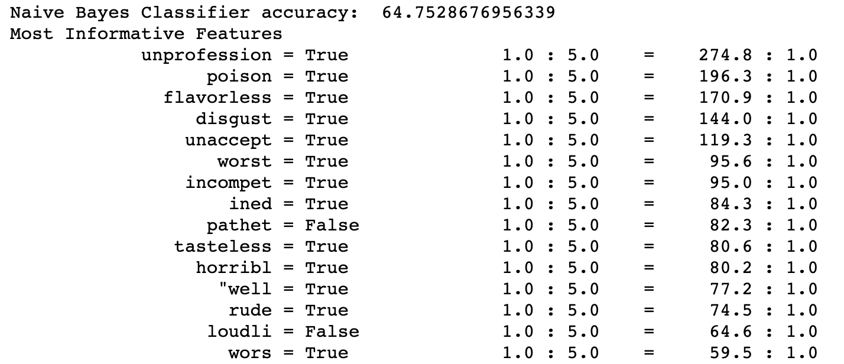
Finding – Nltk.Naïve Bayes classifier for extreme value prediction
Train / Test size: 30000/16651

Slide 21
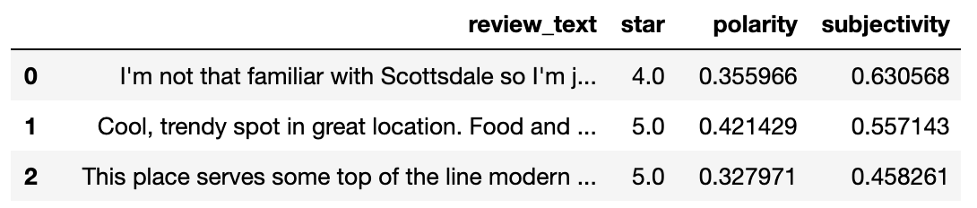
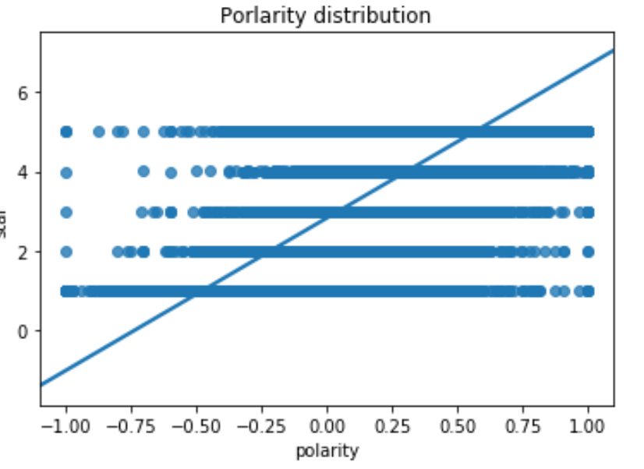
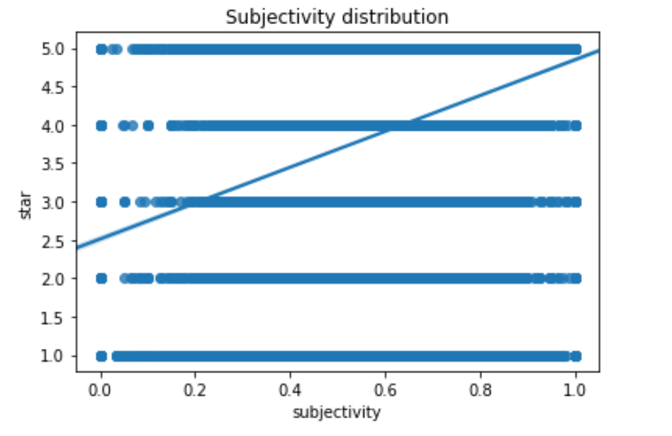
Finding –TextBlob

Slide 22
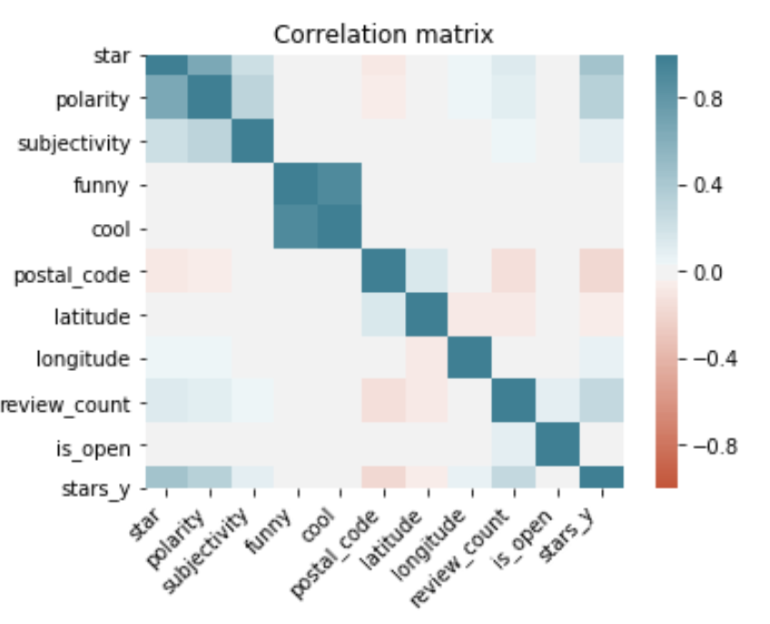
Finding – Feature selection
Choose 7 features:
Polarity
Stars_y
Subjectivity
Cool
Review_count
Longitude
Postal_code

Slide 23
Predictive Analysis - Metrics
 | Gradient Boosting | Gaussian Naïve Bayes | Random Forest | Decision Tree
Accuracy | 61.66 | 58.78 | 55.69 | 48.90
Precision | 52.56 | 51.90 | 39.28 | 49.53
Recall | 61.66 | 58.78 | 55.69 | 48.90
F1 Score | 52.63 | 48.52 | 43.13 | 49.21

Slide 24
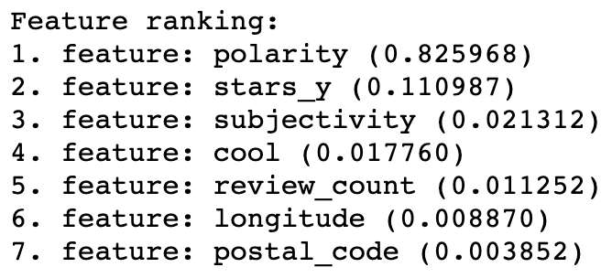
Recommendation

Slide 25
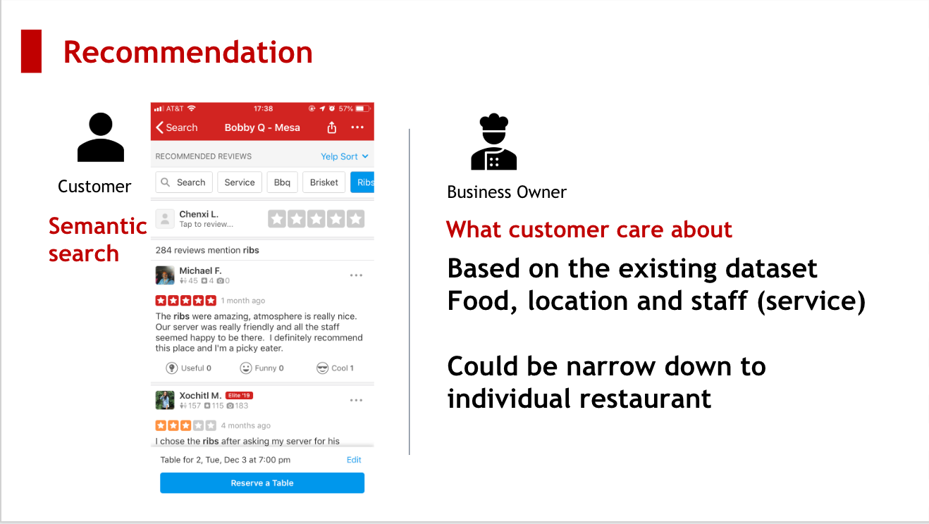

Slide 26
Thank You!

